Slide 1
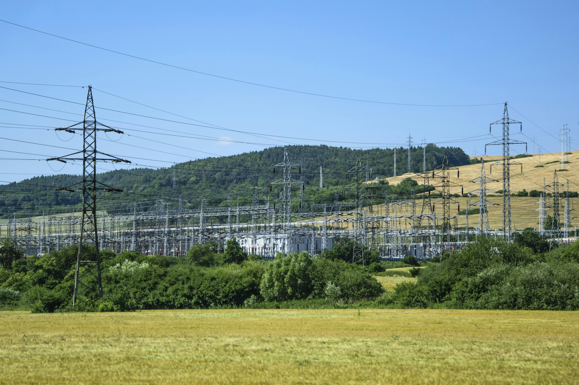


Performance Based Regulation (PBR)
STAKEHOLDER WORKGROUP MEETING #4
Virginia Department of Energy
Glenn Davis
Director
Virginia Department of Energy
Larry Corkey
Manager, Policy and Planning
Virginia Department of Energy
Jonika Rathi
Research Analyst
Virginia Department of Energy
February 28th, 2025

Slide 2



Stakeholder group
Appalachian Power
Appalachian Voices
Chesapeake Climate Action Network
Clean Virginia
Climate Action Alliance of the Valley
Commission on Electric Utility Regulation
Current Energy Group
Data Center Coalition
Department of Energy
Department of Environmental Quality
Dominion Energy
Great Plains Institute
Office of Attorney General
Old Dominion Committee for fair Utility Rates
Natural Resources Defense Council (NRDC)
New Virginia Majority
NRG Energy
Pacific Economics Group Research LLC
Pacific Northwest National Laboratory
Plan RVA
Regulatory Assistance Project (RAP)
Rocky Mountain Institute (RMI)
Secure Solar Futures
Sierra Club Virginia Chapter
Solar United Neighbors
Southern Environmental Law Center VA
The Nature Conservancy
The Virginia Grassroots Coalition
Virginia Association of Counties
Virginia Energy Consumer Alliance
Virginia Energy Purchasing Governmental Association
Virginia Committee for Fair Utility Rates
Virginia League of Conservation Voters
Virginia Manufacturers Association
Virginia Municipal League
Virginia Organizing
Virginia Poverty Law Center
SCC PBR STUDY

Slide 3
AGENDA
Meeting #4
Welcome
Review of the Enabling Stature of the legislation – Great Plains Institute and Current Energy Group
Goal setting for the PBR process in the Commonwealth
Introduce Regulatory Assessment Exercise.
Next Steps and Closing
SCC PBR STUDY

Slide 4
Stakeholder proposals
Meeting #6 & #7
Requesting volunteers to present their PBR concepts to the group
Proposal could set out wide-ranging alternative to current ratemaking or address one specific area
No set time requirement or format – VA Energy will work with presenters to find what suits their proposal
Let us know by March 7 if you want to present.
SCC PBR STUDY

Slide 5
Review of the Enabling Stature of the legislation
Great Plains Institute and Current Energy Group
SCC PBR STUDY

Slide 6
Goal setting for the PBR process in the commonwealth
SCC PBR STUDY

Slide 7
Goal setting for the stakeholder group
  Goal for organizations or individuals -
  What do you want to get out of the stakeholder process and what input do you want to provide?
2. What should be the top three goals for the output from the stakeholder process?
    Goals could be in terms of final report format, types of recommendations to the SCC, key subjects to address, etc.
    Reflect priorities for the group that can be reasonably addressed in the time we have.
SCC PBR STUDY

Slide 8
Goal setting for the stakeholder group
    20 minutes for the breakout groups
      Suggest 10 minutes each for Questions 1 & 2.
    Each breakout room will have a facilitator
    Volunteers in each group to take notes in a document, share on screen is possible, and report out on the group's discussion.
      Notes will be sent to jonika.rathi@energy.virginia.gov
    Each group will report out on individual priorities and their top 3 goals
SCC PBR STUDY

Slide 9
regulatory assessment template
SCC PBR STUDY

Slide 10
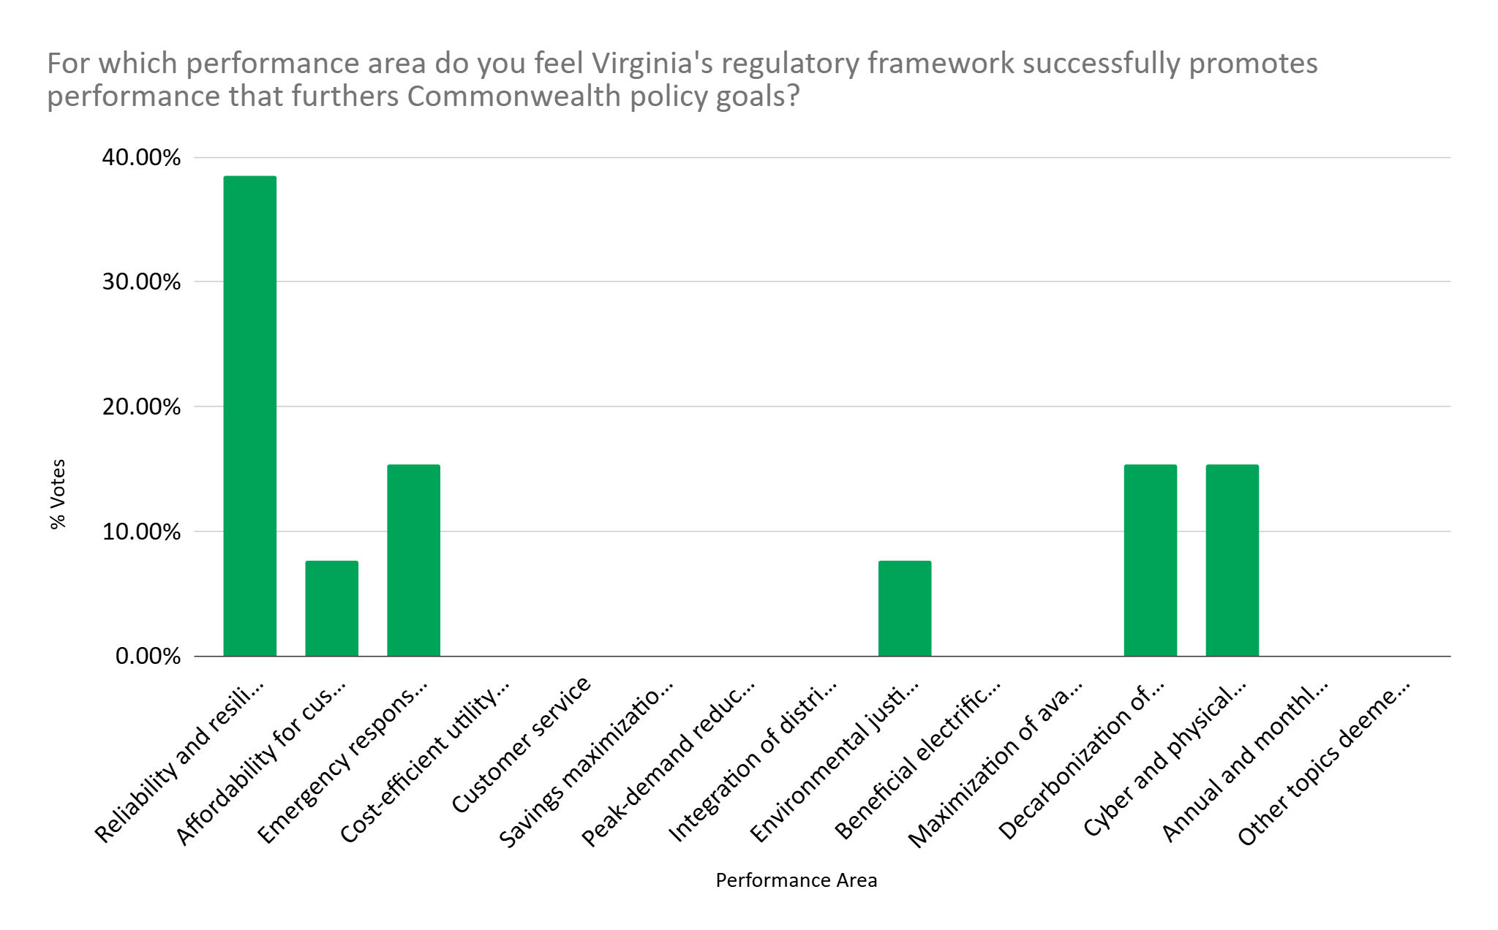
Virginia's Current Regulatory Framework Survey
SCC PBR STUDY

Slide 11
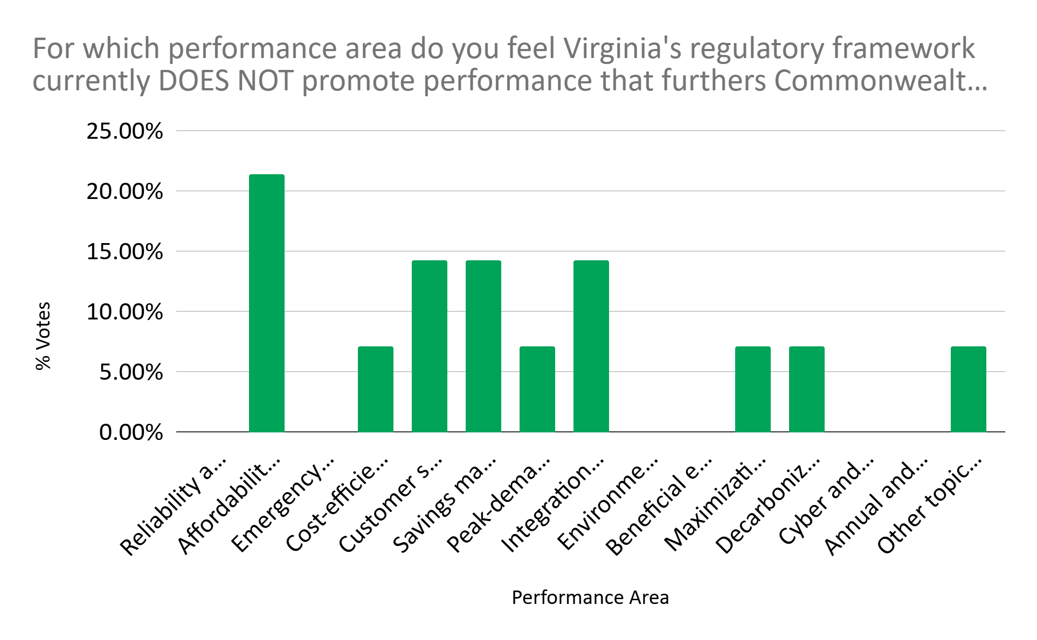
Virginia's Current Regulatory Framework Survey
SCC PBR STUDY

Slide 12
Rate reviews
Backwards-looking (w/ earnings adjustments)
Conducted every two years
Cost of Service – Cost of providing utility service to customers.
  Includes recovery of the following: operating expenses, capital expenditures and financing costs (including profit margin).
Rate Base - The amount of investment a utility has made but not yet recovered from customers. The amount a utility finances and thus have an opportunity to earn its cost of capital on.
SCC PBR STUDY

Slide 13
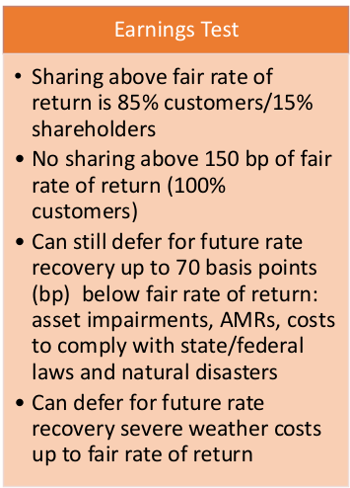
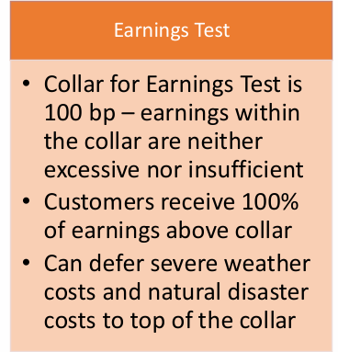
Rate reviews
Backwards-looking (w/ earnings adjustments)
Appalachian Power
Dominion Energy
SCC PBR STUDY

Slide 14
Energy efficiency standard
Energy efficiency savings target (ROE adder applied to DSN operating expenses)
Virginia Clean Economy Act established an Energy Efficiency Resource Standard (EERS)
  For Dominion, a 5% reduction by 2025 using 2019 sales as baseline
  For Appalachian Power, a 2% reduction by 2025 using 2019 sales as baseline
  SCC will set post-2025 targets
SCC PBR STUDY

Slide 15
Energy efficiency standard
Energy efficiency savings target (ROE adder applied to DSN operating expenses)
IOUs required to meet energy savings targets through energy efficiency programs
If targets are met, IOUs earn same return on equity (ROE) as on capital projects
If targets are exceeded, bonus can be earned – 20 basis points per additional 0.1% reduction
If targets not met, no new CPCN for new fossil-fueled generation, unless SCC determines for reliability
SCC PBR STUDY

Slide 16
regulatory assessment template
Complete by March 6 if possible for dissemination before next meeting
  March 14 final date for completion
Contact us if you have any questions
SCC PBR STUDY

Slide 17
Next steps
SCC PBR STUDY

Slide 18
next steps
Timeline :
  Fill in the template and send by 6th March if possible.
  Send Interest to present proposals on their suggested PBR schemes to the group by 7th March.
  Calendar polls for future meetings close at EOD on March 6th, 2025.
  Ongoing open public comment period open until the final comments on the draft report are due.
SCC PBR STUDY

Slide 19
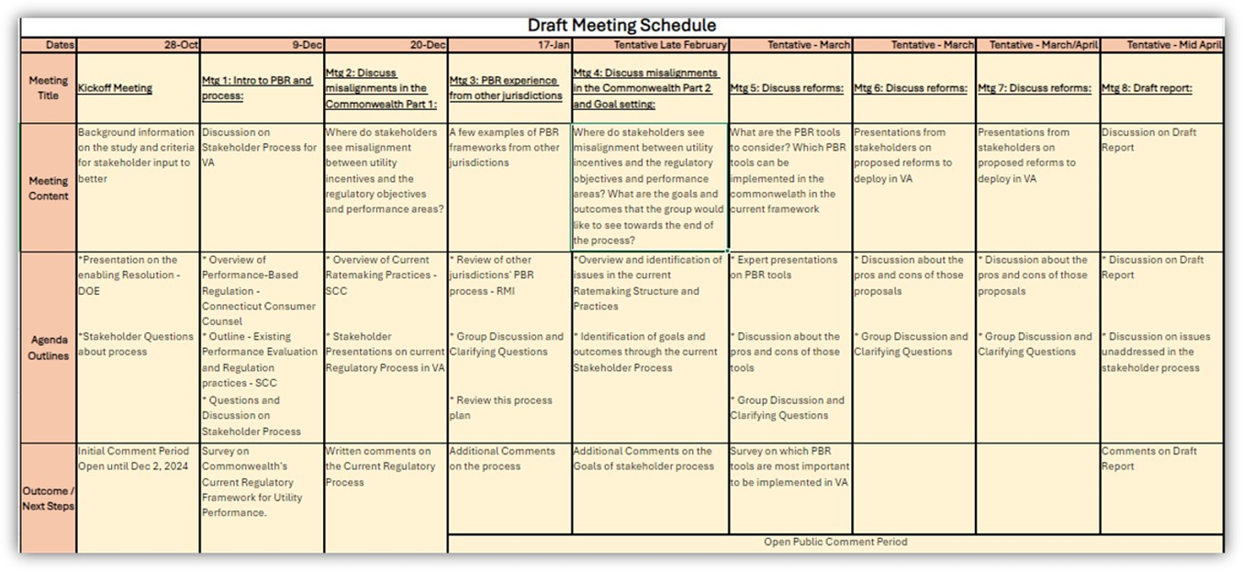
SCC PBR STUDY

Slide 20
next steps
  Stakeholder Group Meeting #5 is scheduled for 10th March from 1 pm – 4 pm
  Regulatory Assistance Project (RAP) will present on different PBR mechanisms
SCC PBR STUDY

